Slide 1
DATA VISUALIZATION ON LANDMARK ISSUES
WEB/MOBILE PROGRAMMING
Navya gonuguntla
MADHURI SARDA
JAYAPRAKASH RAVELLA

Slide 2
Content
Introduction
Motivation
Platform/Tools/Languages involved
Work Done So Far
Future Work In Increment-2

Slide 3
Landmark Issues?
There are a set of rules that each construction should abide by.
These are a set of rules that differ from a city to city
If these rules are broken, then it is called a violation.
There can be a series of landmark violations ranging from burglary, robbery, trespassing etc.

Slide 4
Motivation
It is particularly important to consider landmark violations
Driven personal motivation of being daunted by out landlord for not following landmark rules and regulations properties.
Drove us in learning more about landmark properties and use the data available on the internet and make the most interesting and useful analytics out of it.

Slide 5
Motivation (Contd.)g
Every city has its own rules and regulations that the citizens of the state needs to abide by.
Fetching the data from the internet about landmark violations and making useful analysis would actually help us to understand information regarding crime rate, hygiene conditions and many other factors of a neighborhood

Slide 6
Platform/Tools/Languages involved
HTML, CSS
JavaScript, AngularJS
Microsoft Visual Studio Code IDE

Slide 7
Datasets Used
The following datasets are being used for making API calls,
Census agency has demographic survey of United States citizens from 2010 to 2019. It is American Community Survey dataset. It contains the needed demographic information such as race, age and gender of people living locality wise (zipcode wise).
https://www.census.gov/data/developers/data-sets/acs1year.html
Data.gov is the federal government’s open data site. We are using information provided by this website to fetch data.
https://www.data.gov/open-gov/

Slide 8
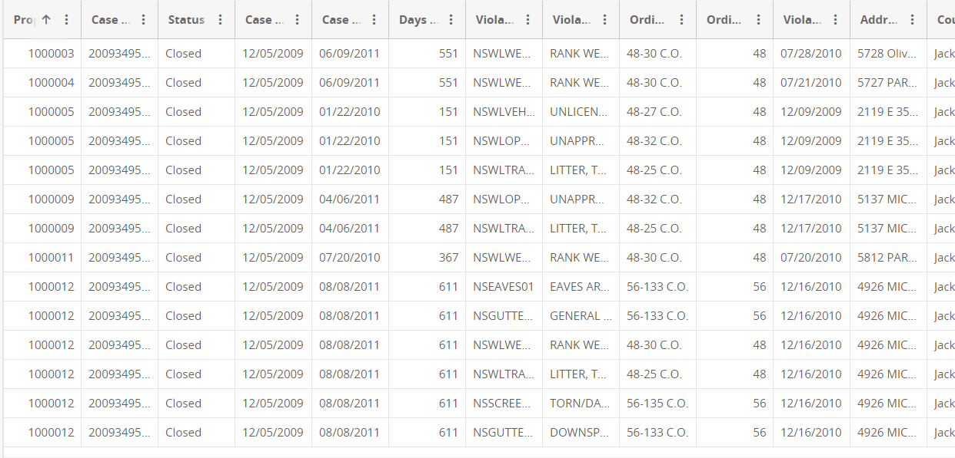
Sample Data

Slide 9

Homepage

Slide 10
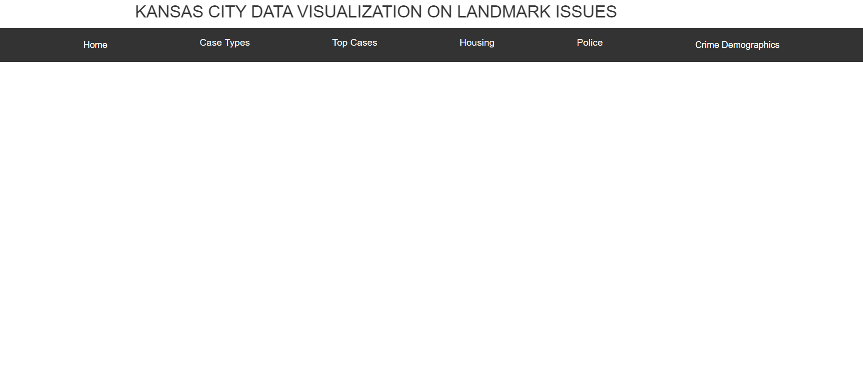
Homepage (Cont)
There are two buttons designed. Clicking on the city’s name would redirect to a new page that displays a series of valuable and useful information.

Slide 11
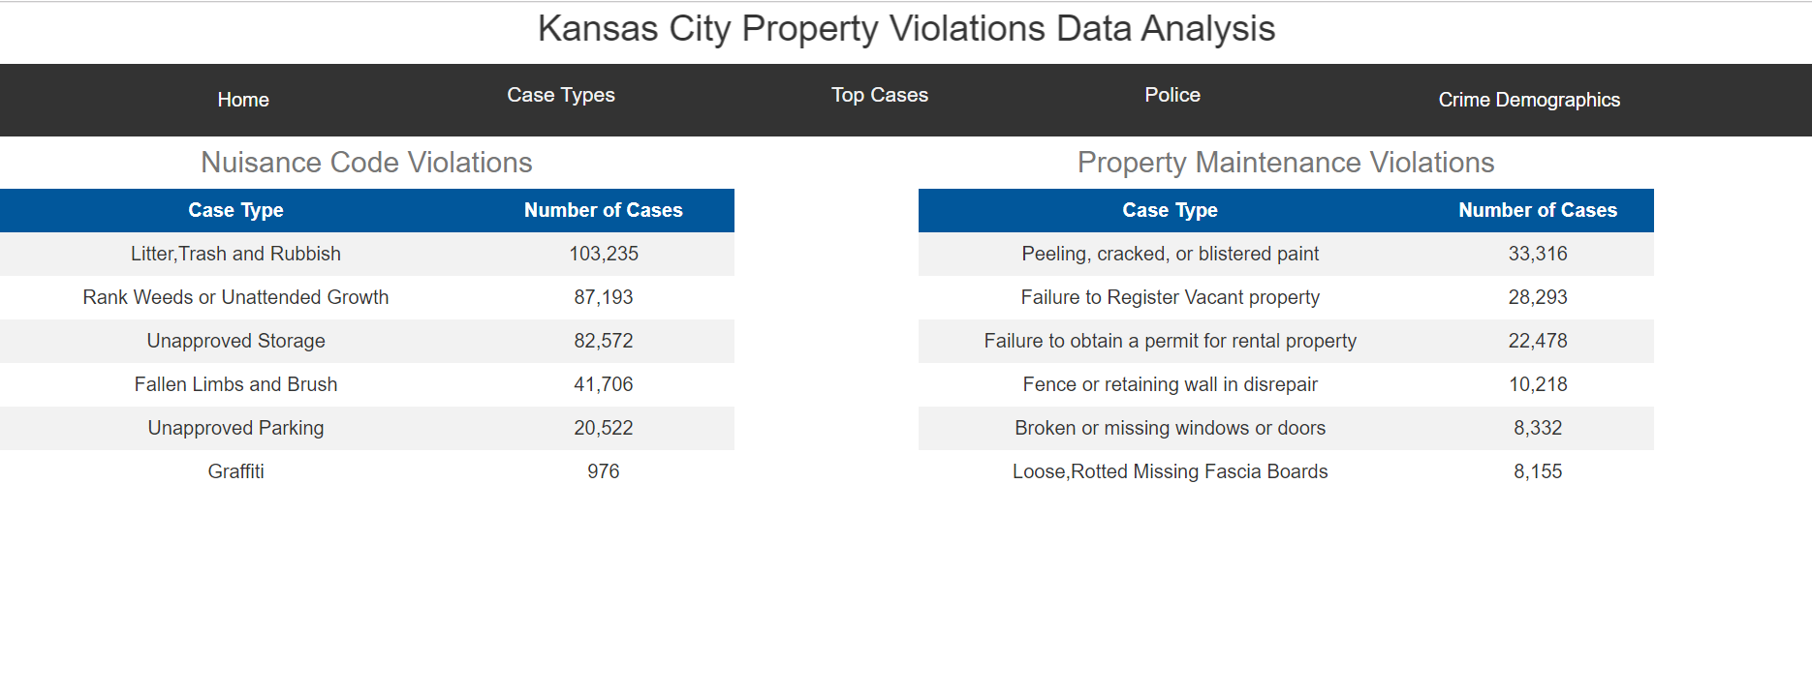
Types of property violation cases in KC
Property violations are divided into two different categories
Nuisance Code Violations
Property Maintenance Violations

Slide 12
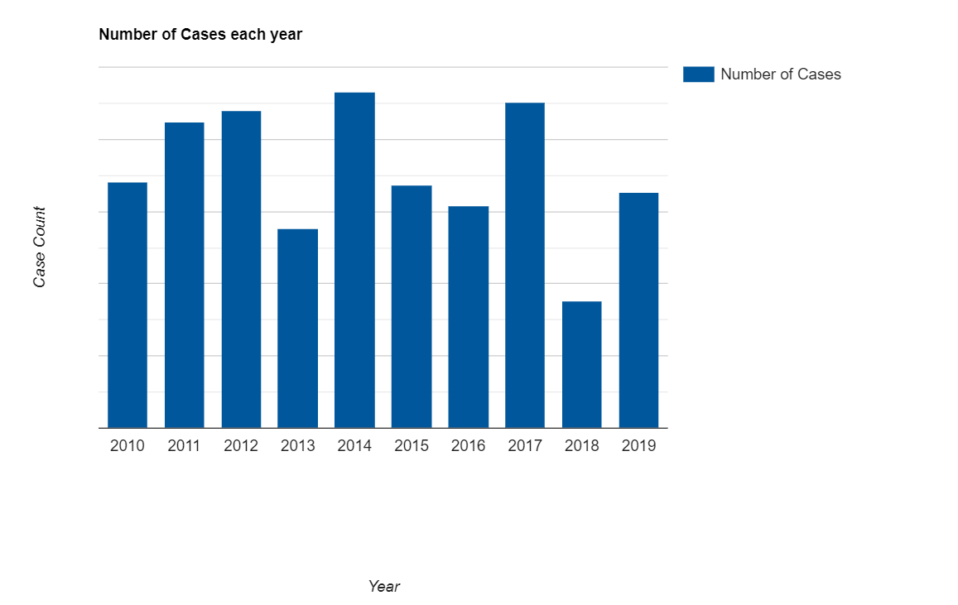
Number of cases filed from 2010 to 2019
Highest number of property violation cases are recorded in the year 2014 (93,016 cases) while the least were observed In the year 2018 (35,241 cases). There was a fluctuation in the total number of property violations filed in the last decade.

Slide 13
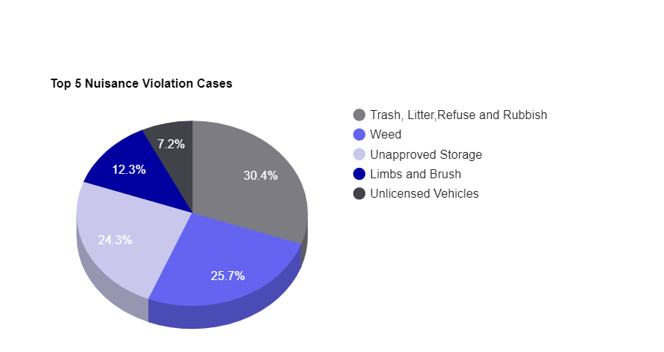
Top 5 nuisance violation cases
The following pie chart signifies the top 5 nuisance cases that takes place the most.

Slide 14
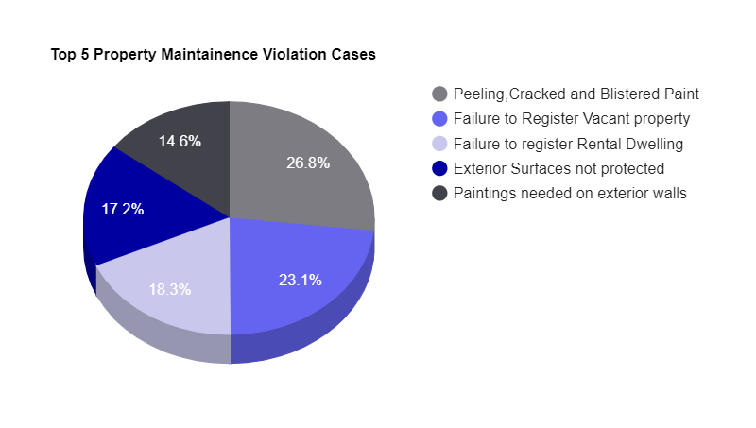
Top 5 property maintenance violation cases
The following pie chart signifies top 5 property maintenance violation cases filed

Slide 15
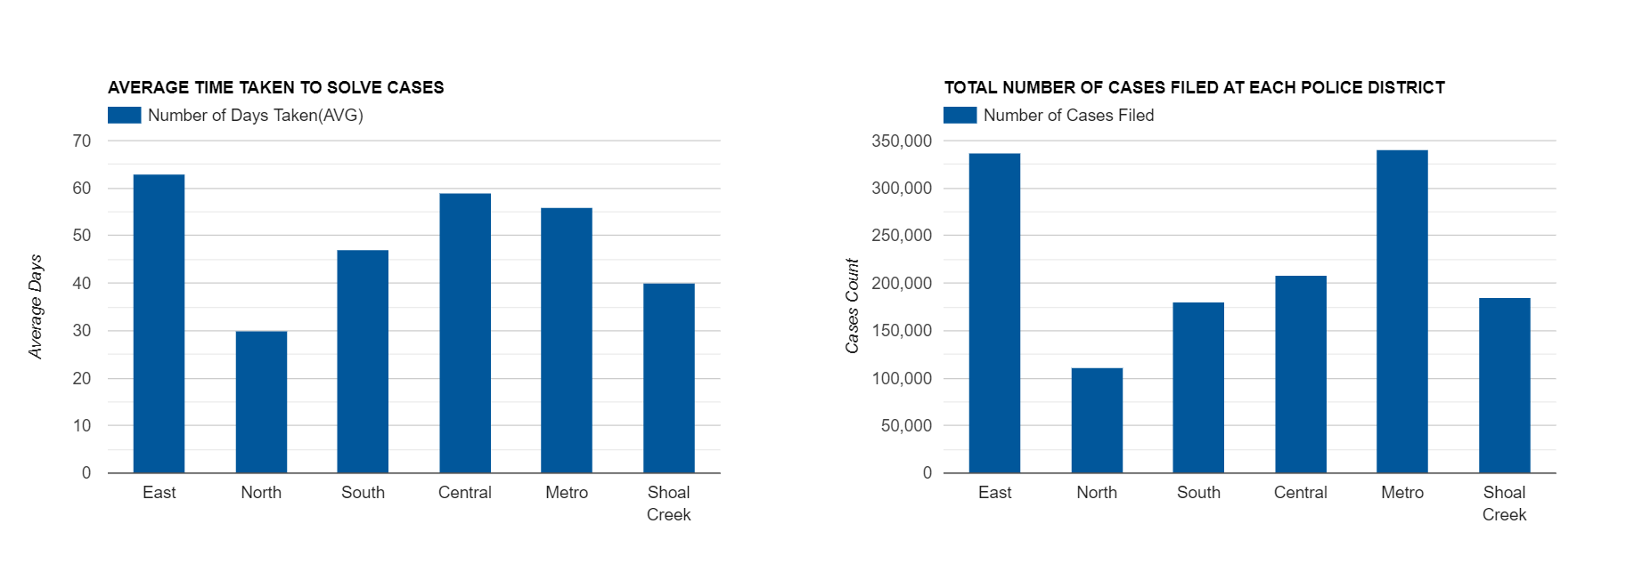
Time taken by each police district to solve cases and total number of cases filed at each police district
The following column charts depict the average number of days taken by each police district to solve violation cases and total number of cases filed at each police district. It can be observed that although the number of crimes are quite less at central (208687 cases solved in an average of 59), the average time taken by central to solve cases is high. Also Metro (340,572 cases solved In an average of 56 days) works relatively well considering the number of cases filed there.

Slide 16
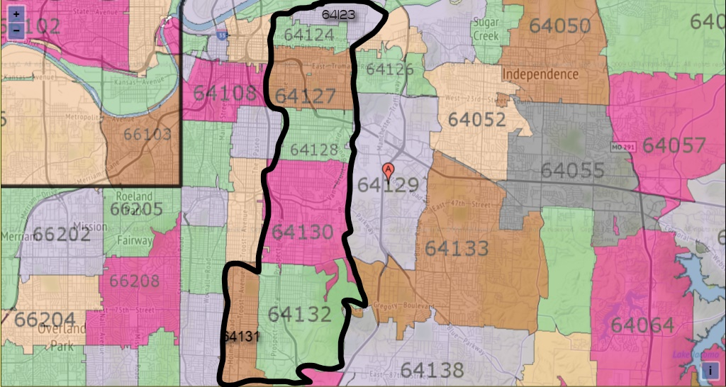
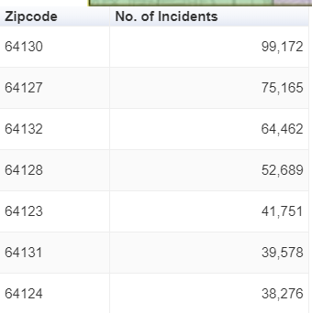
Top 5 zip codes where property violations filed the most
Top 7 zip codes where violation cases are filed the most. It can be observed that all these zip codes lies next to each other and are next to Troost Avenue. From this, Violation cases that takes place are contagious.

Slide 17
DEMOGRAPHICS OF PROPERTY CRIME DATA ANALYSIS
The following screenshots depicts the demographics associated with property crimes
Property crimes we considered includes
Property Damage
Robbery
Burglary in Residence
Armed Robbery
Trespassing

Slide 18
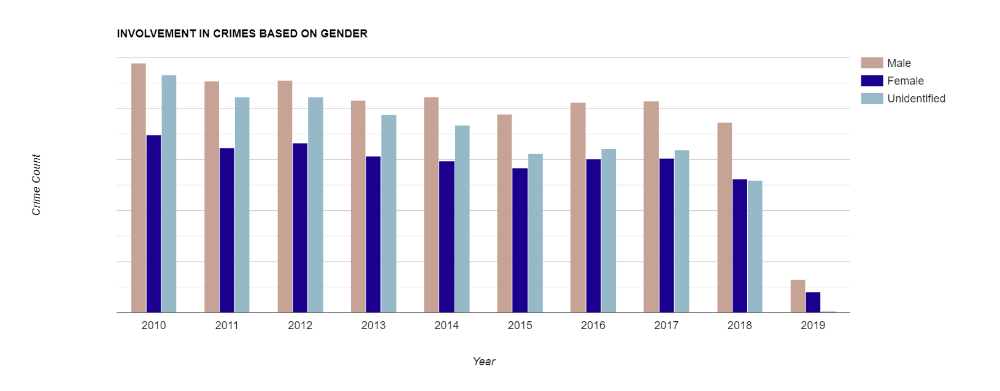
Involvement in crimes based on gender (Arrestees)
Nearly a decade of data analyzed says that the average difference between Male and Females who committed crimes is quite less (Around 2000) each year

Slide 19
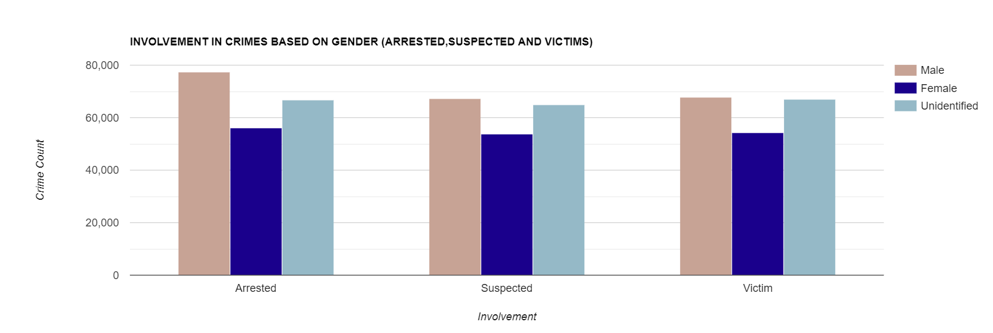
Involvement in crimes based on gender (Arrested, Suspected, Victims)
Males dominates the most in all arrested, suspected and victim's category. While, unidentified category is also significant. Female category is almost under the same range (Approx 50000) in all these categories.

Slide 20
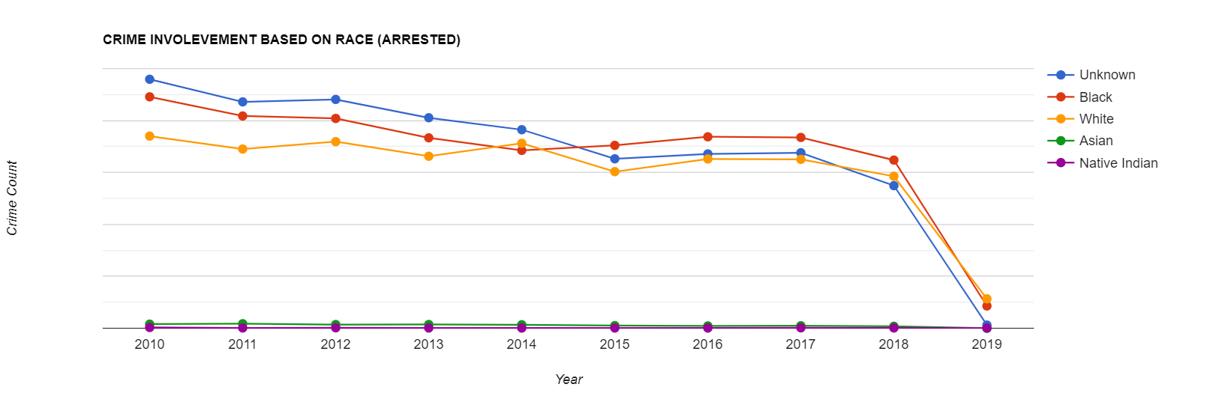
Involvement in crimes based on race (Arrested data)
Involvement of Unknown race, Blacks and Whites top the most while Native Indians involvement in property crimes in negligible over the years. A slight decrease in Black arrestees in property crimes over the last decade can be observed.

Slide 21
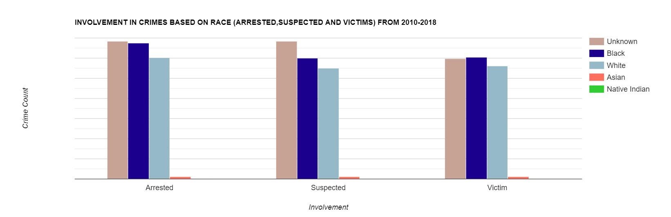
Involvement in crimes based on race (Arrested, suspected and victims)
Unknown category tops the most in all three categories (arrested, suspected and victims) followed by Black category. Opposing conventional opinions, Black victims are high compared to white and other races.

Slide 22
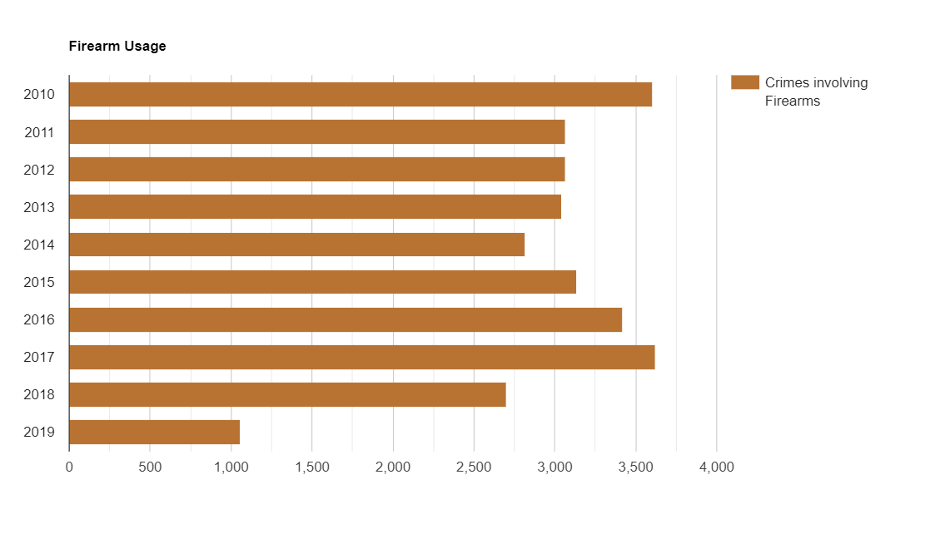
Firearm usage in property crimes
Firearm usage in armed robbery is depicted in the below bar chart. 2010 is the year with highest number of property crime cases with firearms involved. Cases filed were 3602. Since then there was a decrease for four years and again an increase in the last four years.

Slide 23
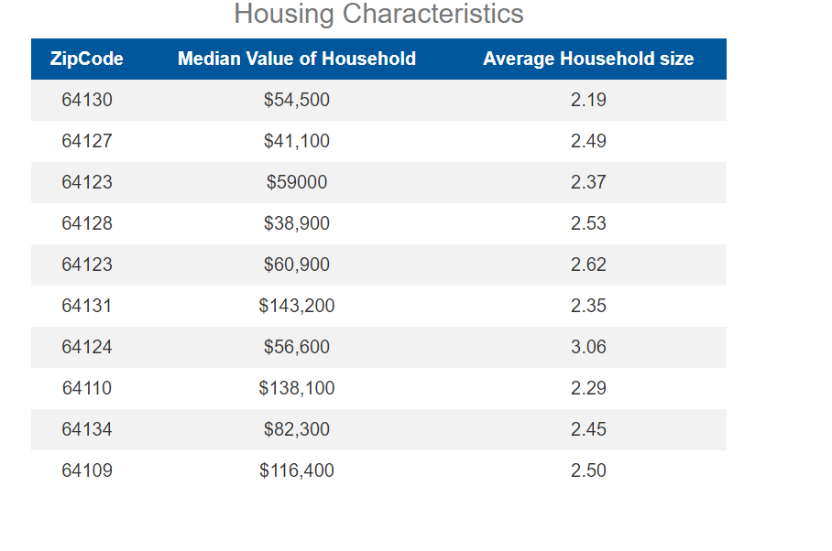
Housing Characteristics
It has been observed that all the places(zip codes) where property violations occur the most, the house values of most of these localities lies below the median value of the house worth of Kansas city.

Slide 24
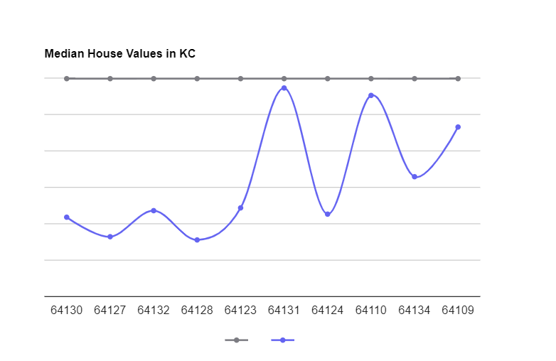
Housing Characteristics
It has been observed that all the places(zip codes) where property violations occur the most, the house values of most of these localities lies below the median value of the house worth of Kansas city($149,600).

Slide 25
Correlation between income levels and property violations
It has been observed that all the places(zip codes) where property violations occur the most, the household income of these localities lies below the median value of the household income of Kansas city($56,422).

Slide 26
NEW YORK CITY PROPERTY VIOLATIONS DATA ANALYSIS

Slide 27
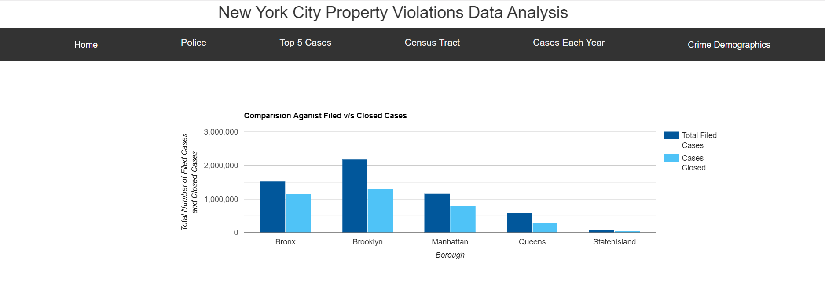
Number of property violation cases filed at each precinct
In NYC, Highest number of violation cases were filed at Brooklyn (Filed cases till date are 2183082). Also, from comparing total number of cases and closed cases filed at each precinct, It can be observed that all these precincts work efficiency is relatively the same.

Slide 28
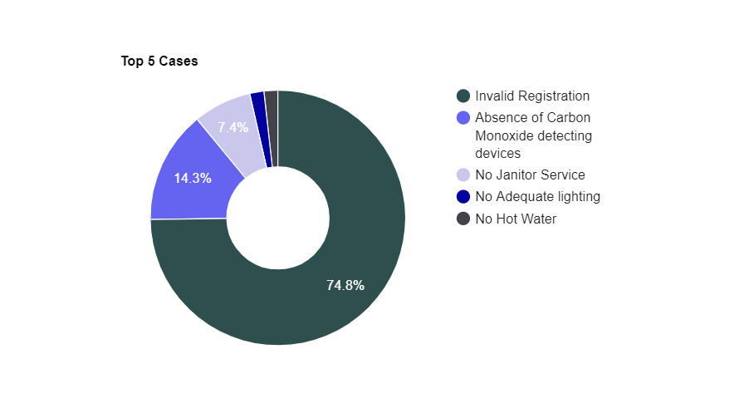
Top 5 property violation cases in NYC
Top 5 violation cases filed in NYC are as follows:
Invalid Registration
Absence of Carbon Monoxide detecting devices
No Janitor Service
No Adequate lighting
No hot water
Invalid registration tops the most with 74.8% of total property violation cases.

Slide 29
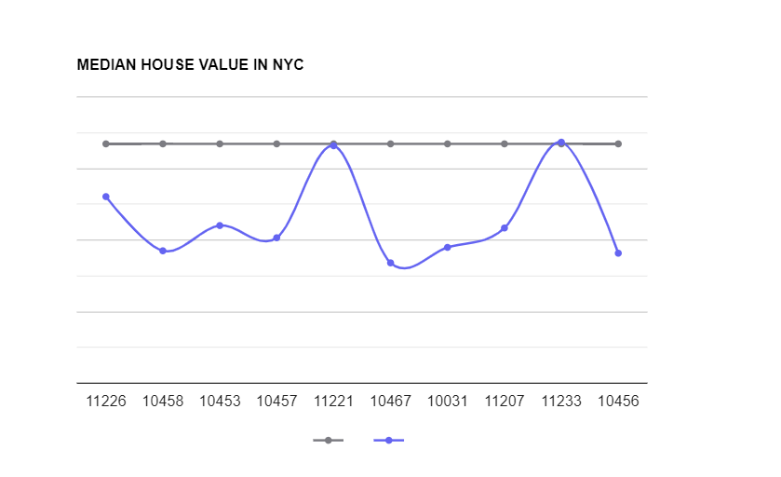
Housing Characteristics
It has been observed that all the places(zip codes) where property violations occur the most, the house values of most of these localities lies below the median value of the house worth of NYC city($668,500).

Slide 30
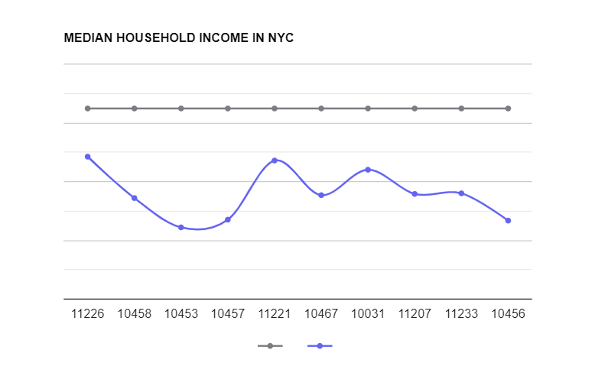
Correlation between income levels and property violations
It has been observed that all the places(zip codes) where property violations occur the most, the household income of these localities lies below the median value of the household income of NYC city($64,894).

Slide 31
Thank You!

